Slide 1

Smart Navigation System For Emergency Exits
Han-Wei Lin
Roger Navarro
Sheetal Narvekar
Swati Ganesh Narkhede

Slide 2


Slide 3
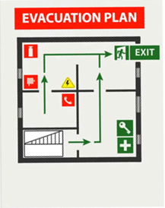


Slide 4


Slide 5


Slide 6


Slide 7
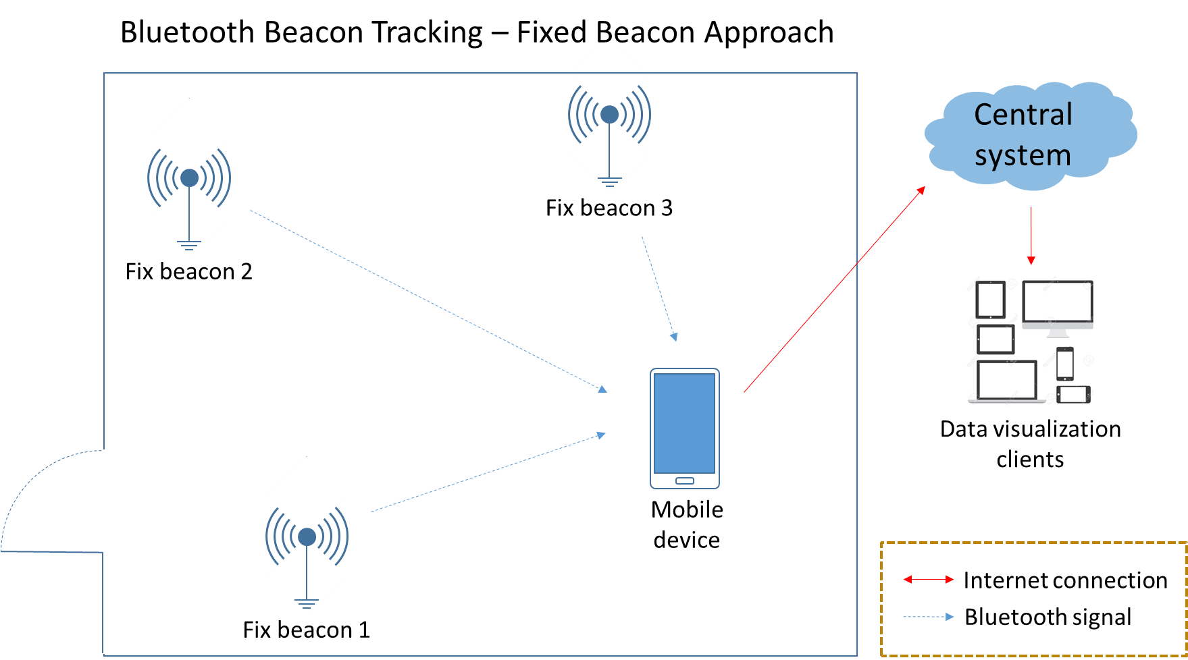

Slide 8
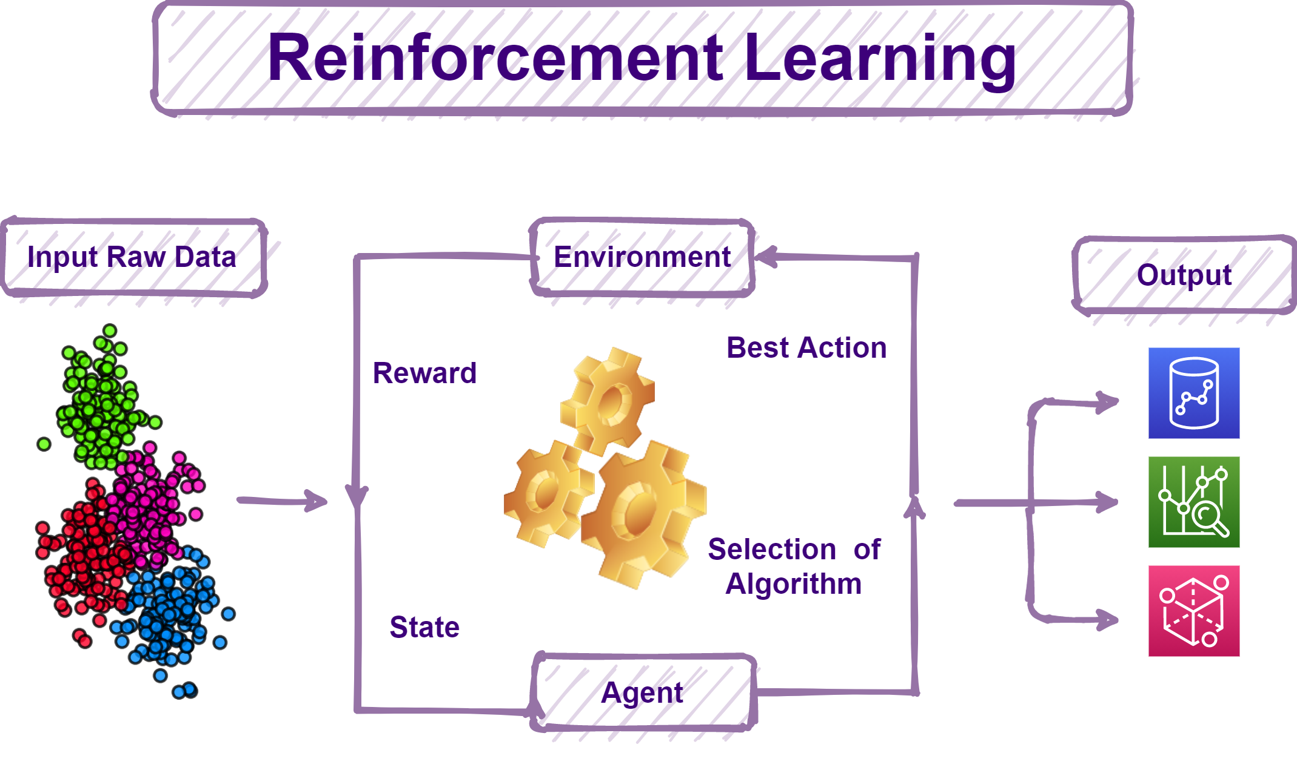

Slide 9
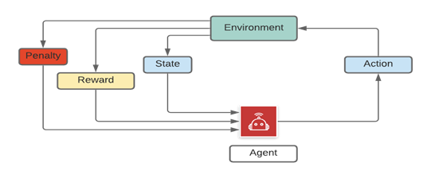
Machine Learning for Shortest Path Generation
Q-Learning Algorithm of Reinforcement Learning

Slide 10
Q Function
Q(s,a) <= (1-α)Q(s,a) + α(R(s,a)+γmaxQ(s’,a’))

Slide 11
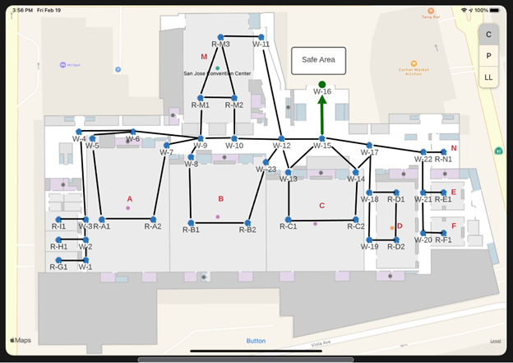

Slide 12
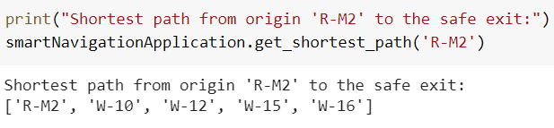
Generate a Shortest Path to the Safe Exit
Case 1: The path is available.

Slide 13
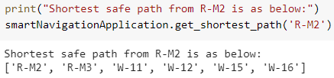
Case 2: The path is blocked and alternate path is available.

Slide 14
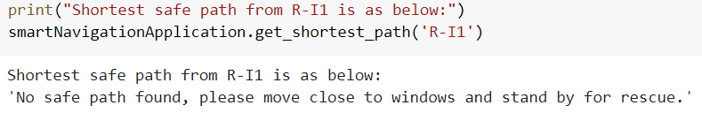
Case 3: The path is not available but room has a window.

Slide 15
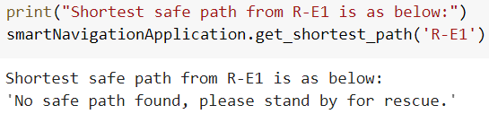
Case 4: The path is unavailable and room does not have window.

Slide 16
















Technology Stack
Notes:
By Lin

Slide 17
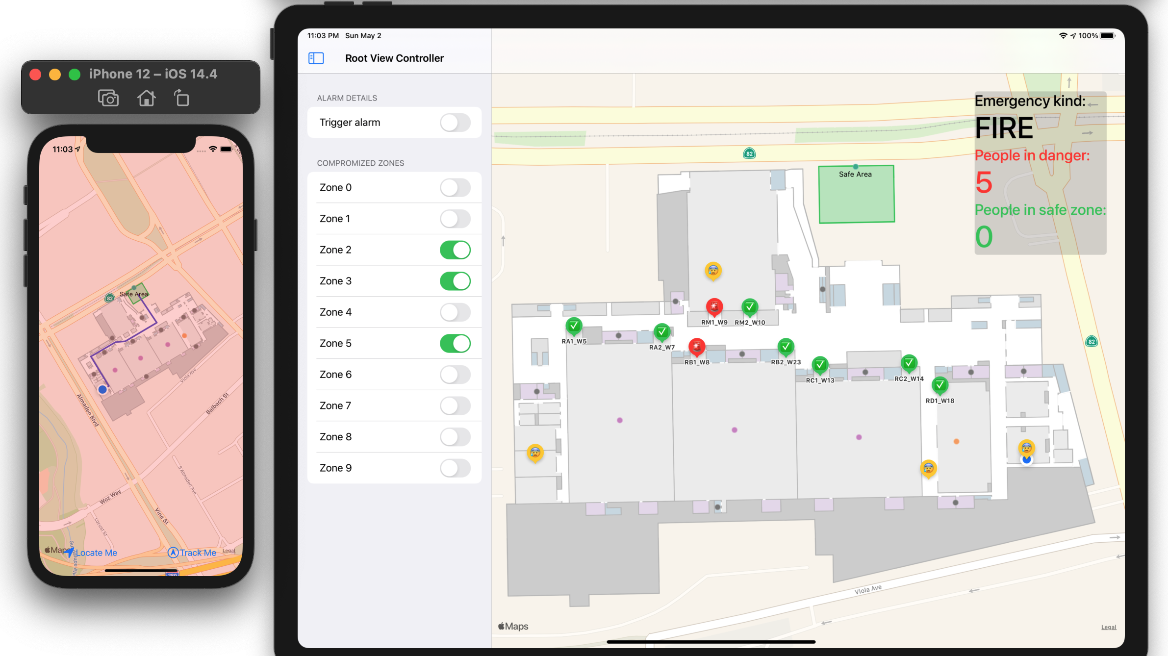

Slide 18
Credits
https://techvidvan.com/tutorials/reinforcement-learning/
https://starherald.com/townnews/school/scottsbluff-public-schools-practice-fire-drill-and-reunification-plan/article_eeed2982-0e47-5272-a207-e328d0fce806.html
https://spaces4learning.com/articles/2014/07/01/fire-drill.aspx
https://www.todaysoftmag.com/article/2225/bluetooth-beacon-tracking-it-works-both-ways
Images in technology stack are from: lucid.app, Google, Python, Swift

